Slide 1
Predicting the risk factors of cardiology diseases
The main objective of this project is to explain which risk factors are more important in cardiology diseases and their relation .

Slide 2
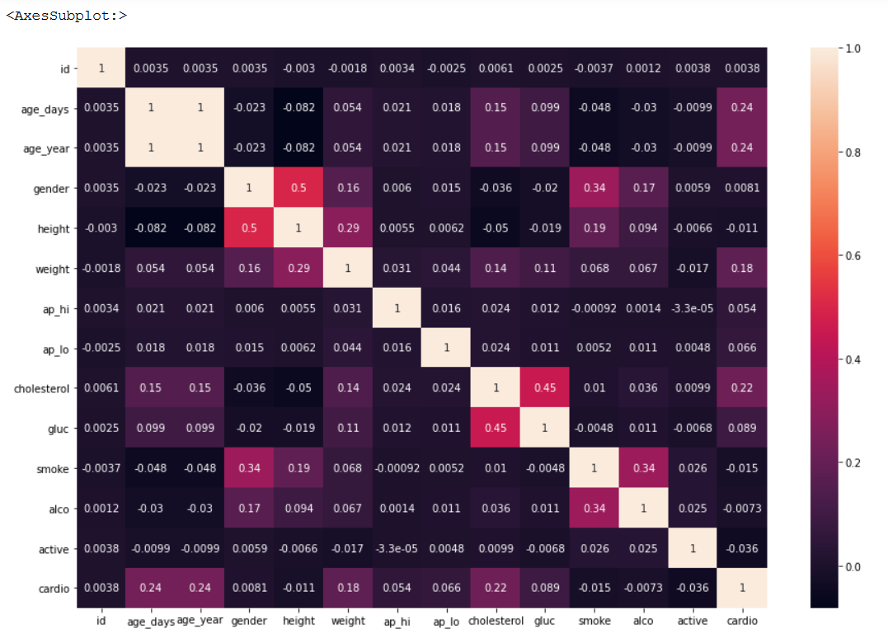
There is a correlation between cardio and other features

Slide 3
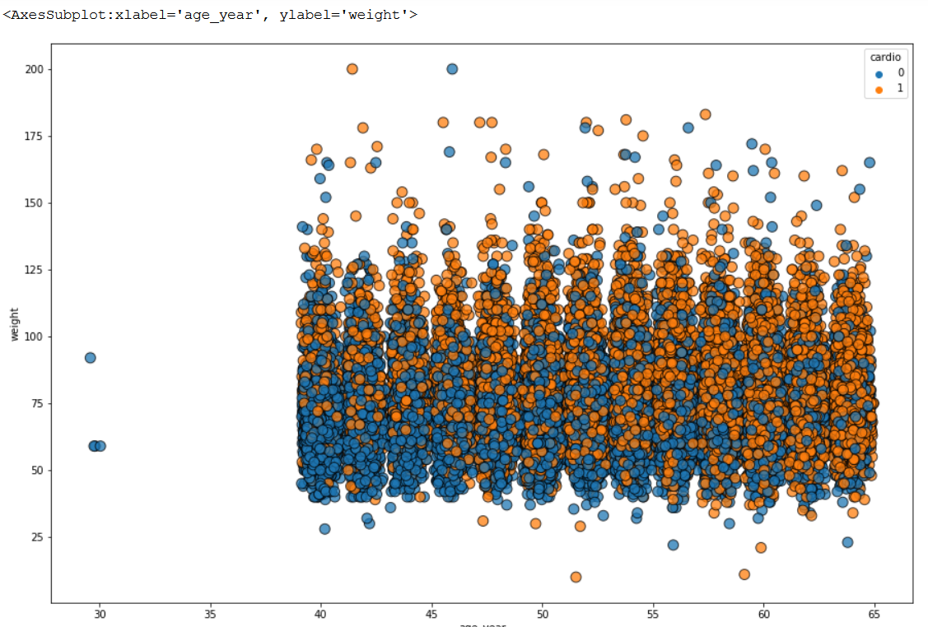

Slide 4
According to this scatterplot, increase age significantly increase the risk of cardiology diseases.

Slide 5
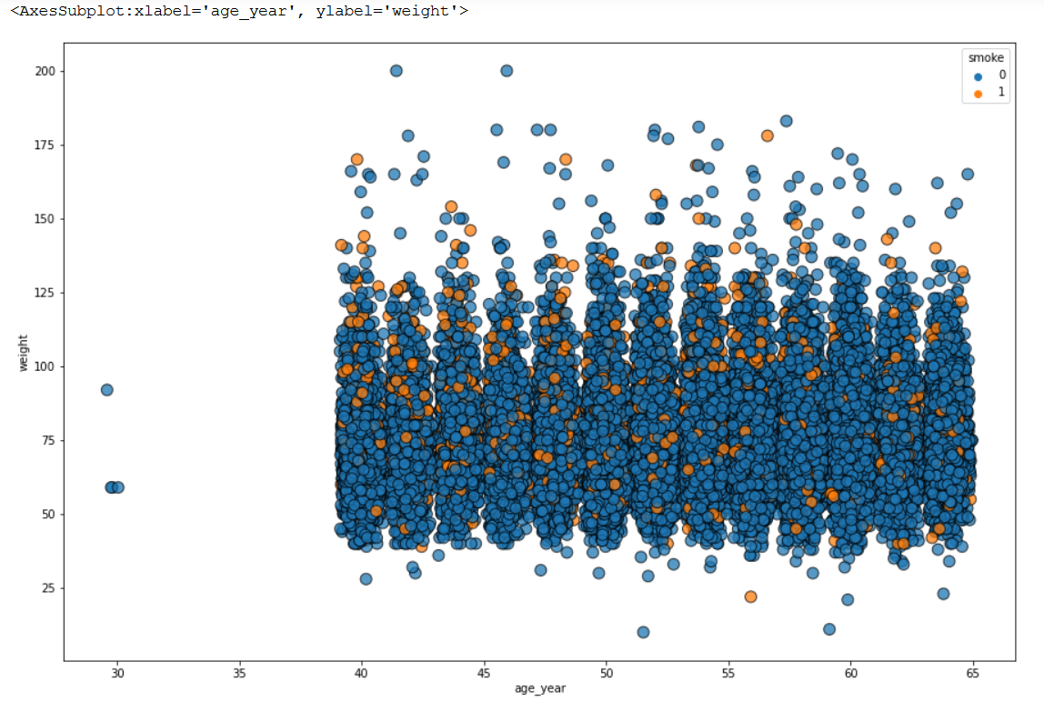
I found that in age 40 smoke more than in age 65 .

Slide 6
models
I used first LogisticRegression and I get score 0.59
k-nearest neighbors with score 0.81
RandomForest with score 0.998
DecisionTree which is best score 0.999

Slide 7
